Slide 1




When
Robots Bleed
Delete this & put logo here
Total Letdown Games

Slide 2

1
Overview of the game

Slide 3

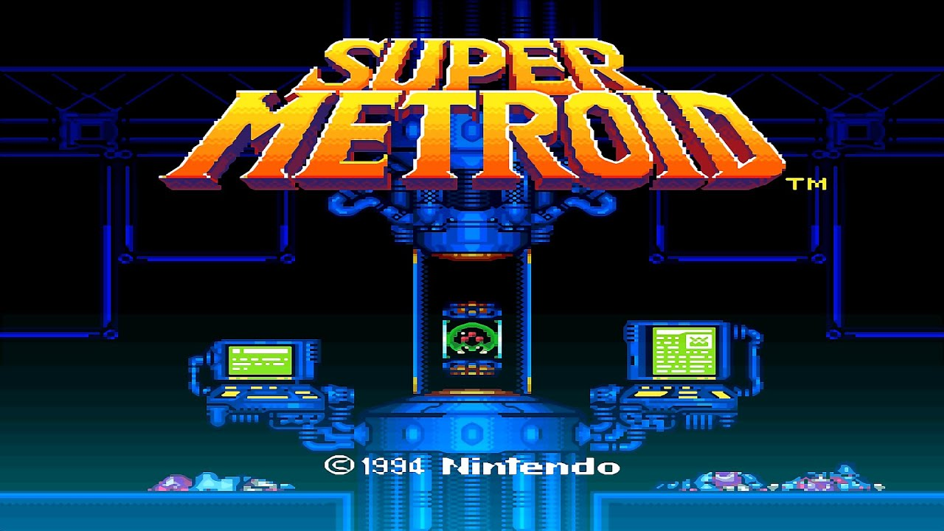
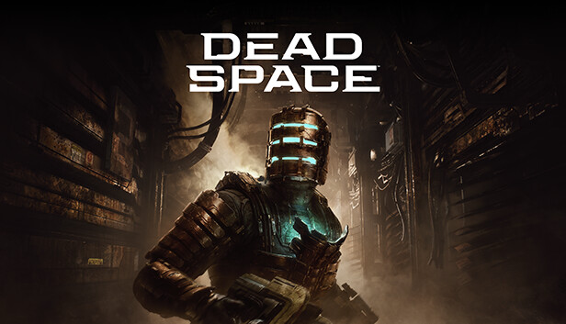
What is When Robot Bleed

Slide 4
Main Gameplay
Explore the world: Platform and explore out a factory long gone. Find hidden secrets and open up new path to explore to find the center of all this chaos.
Survive: Robots that has been hijacked from the AI are hostile towards you and you must fight them. Not only that but specialized robotic units made for security will hunt you down relentlessly and can not be destroyed.
Become Stronger: As you explore the world find new powers and abilities that will help in solving puzzle, combating enemies, and to open new paths. You can also level up from killing enemies or from finding items that give exp. With each level allowing you to upgrade your skills and abilities.

Slide 5
Unique Selling Points
2

Slide 6
Unique Selling Points
A Survival-Horror/Metroidvania hybrid: fusing horror chase sequences and events that make the player vulnerable with classic metroidvania level exploration and mechanics.
Repair to survive: You awake as a broken down robot. Repair and upgrade yourself with the experience and parts dropped by the enemies and bosses you kill as you make your way through the treacherous factory.
Humanity is gone, and robots only remain: immerse yourself into a story about a desolate world inhabited solely by robots. Unravel who you are and who is the entity responsible for making most of the robots killers in the factory.
You’re alone: Explore and get lost in the world presented with gritty 2D pixel aesthetics and a haunting ambience.

Slide 7
.
WBE or When Robots Bleed is a grim Metroidvania. In which you can only rely on you, yourself, and your equipment; to survive the dark and
rogue AI-infested rooms of
the Factory.

Slide 8
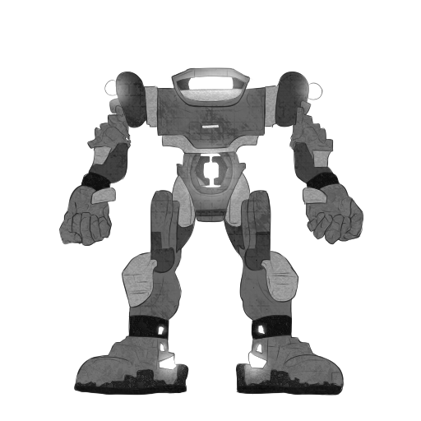
Concept Art: Boss
Notes:
Large tank-like boss with filaments the player needs to destroy in order to beat the boss.
Moves slowly, but does a lot of damage and fires large lasers at the player.
Sturdy with hard metal and layers of rocks covering its body.

Slide 9

Concept Art: Friendly NPC
Notes:
A friendly bug-like robot that frequently aids the player through upgrading their skills and items.
Able to fly and is technologically apt.

Slide 10
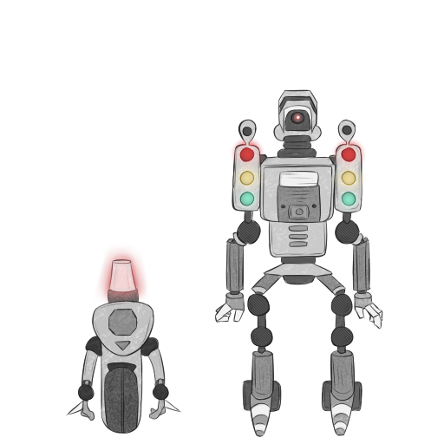
Concept Art: Enemies
Notes:
A special encounter with a co-op robot set.
These robots were contained to the streets, but somehow managed to make their way into the laboratory.
The smaller patrol bot uses a wheel to move around at fast speeds and has two blades on its hands to inflict harm. It uses its siren to alert the larger bot to find and attack the player.
The larger patrol bot fires 3 types of lasers from its traffic lights and uses its surveillance camera to identify and target the player.

Slide 11
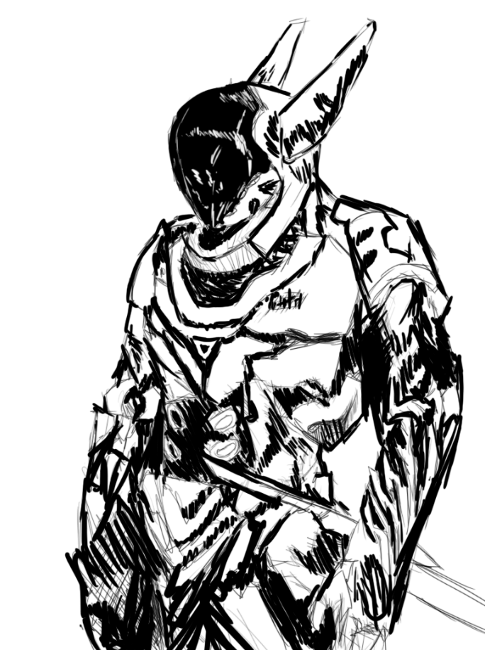
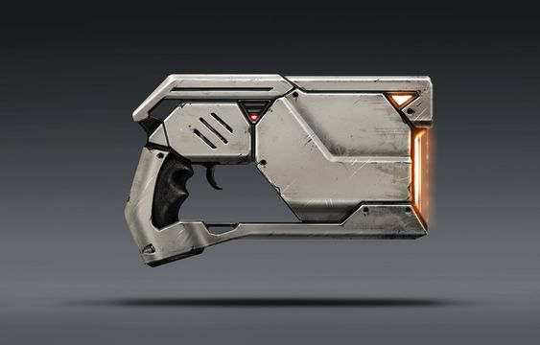
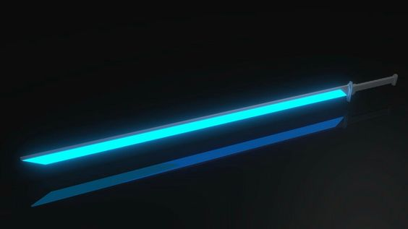
Concept Art: Player Character

Slide 12
3
RECAP
Short description

Slide 13
Description

Slide 14
Thank
you!

